Slide 1
Flight Analysis & Prediction
G’aly Rizq Prima

Slide 2




Experiences
May 2022 - Present
Project Engineer at PT. Satria Inti Prima - Jakarta, Indonesia
3rd Dec 2023 - 27th Dec 2023
Data Scientist Internship at Bukit Vista Hospitality Services, Indonesia
- Collecting data
- Exploratory Data Analysis (EDA)
- Modeling for web scraping
- Cleaning and manipulating data
Nov 2020 - May 2022
Financial and Risk Management Staff at BLU-LPMUKP Ministry Of Marine Affairs And Fisheries Republic Of Indonesia
G’aly Rizq Prima
Education Level
May 2023 – Dec 2023
Bootcamp Data Scientist, DiBimbing - Jakarta, Indonesia
Aug 2016 - Feb 2020
Bachelor’s Degree in Naval Architecture Institute Technology of Sepuluh Nopember - Surabaya, Indonesia
galyrizq@gmail.com
www.linkedin.com/in/galy-rizq-prima/
github.com/galyrizq

Slide 3
Flight Analysis & Prediction

Slide 4
Table Of Contents
01
02
03
04
05
Data Understanding
EDA
Data Preprocessing
Modelling
Recommendation

Slide 5
Data Understanding

Slide 6
Data Understanding
Source : https://www.kaggle.com/datasets/shubhambathwal/flight-price-prediction
airline | The name of the airline company is stored in the airline column. It is a categorical feature having 6 different airlines.
flight | Flight stores information regarding the plane's flight code. It is a categorical feature.
source_city | City from which the flight takes off. It is a categorical feature having 6 unique cities.
departure_time | This is a derived categorical feature obtained created by grouping time periods into bins. It stores information about the departure time and have 6 unique time labels.
stops | A categorical feature with 3 distinct values that stores the number of stops between the source and destination cities.
arrival_time | This is a derived categorical feature created by grouping time intervals into bins. It has six distinct time labels and keeps information about the arrival time.

Slide 7
Data Understanding
Source : https://www.kaggle.com/datasets/shubhambathwal/flight-price-prediction
destination_city | City where the flight will land. It is a categorical feature having 6 unique cities.
class | A categorical feature that contains information on seat class; it has two distinct values: Business and Economy.
duration | A continuous feature that displays the overall amount of time it takes to travel between cities in hours.
days_left | This is a derived characteristic that is calculated by subtracting the trip date by the booking date.
price | Target variable stores information of the ticket price.

Slide 8
Exploratory Data Analysis (EDA)

Slide 9
Airlines Frequency

Slide 10
Destination City Frequency

Slide 11
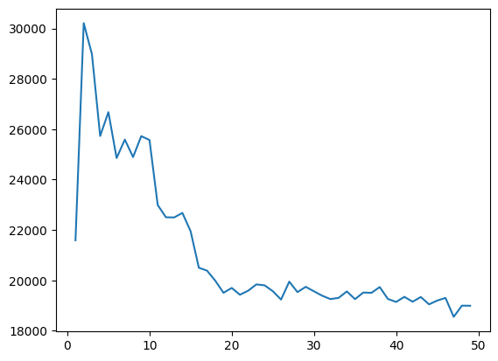
Flight Price Trends Based On Remaining Days
Harga cenderung rendah hingga sisa 20 hari penerbangan
Akan ada kenaikan setelah 20 hari
Akan turun di sisa 1 hari sebelum keberangkatan

Slide 12
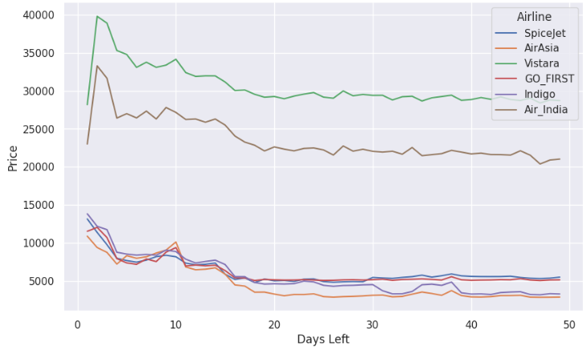
Flight Price Trends Based On Remaining Days Seen From Airlines
Harga pada semua airline akan naik dibawah 20 hari sisa
Hanya Vistara dan Air India yang turun harganya di sisa 1 hari terakhir, yang lain tidak

Slide 13
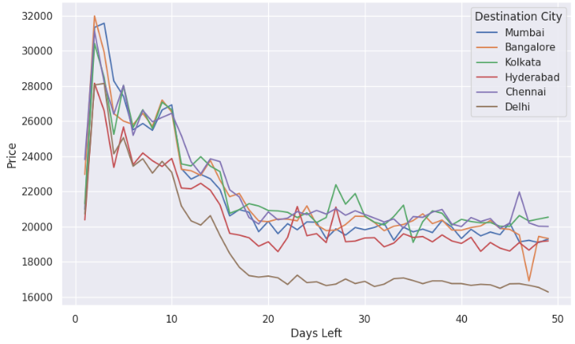
Flight Price Trends Based On Remaining Days Seen From Mumbai As Destination City
Harga pada semua airline akan cenderung naik dibawah 20 hari sisa
Harga Kembali turun di 1 hari sisa

Slide 14
Flight Price Trends Based On Departure Time
Harga termahal yaitu keberangkatan di malam hari
Termurah yaitu berangkat di tengah malam

Slide 15
Flight Price Trends Based On Arrival Time
Harga termahal yaitu kedatangan di sore hari
Termurah yaitu kedatangan di tengah malam

Slide 16
Flight Price Trends Based On Departure And Arrival Time

Slide 17
Flight Price Trends Based On Departure & Arrival From Vistara Airlines

Slide 18
Flight Price Trends Based On Departure & Arrival From Mumbai City As Destination

Slide 19
Flight Price Trends Based On Number Of Stops
Pesawat dengan satu kali stop lebih mahal disbanding direct
Dua kali stop atau lebih memiliki harga paling rendah

Slide 20
Flight Price Trends Based On Number Of Stops From Airlines

Slide 21
Flight Price Trends Based On Number Of Stops From Destination City

Slide 22
Data Preprocessing

Slide 23
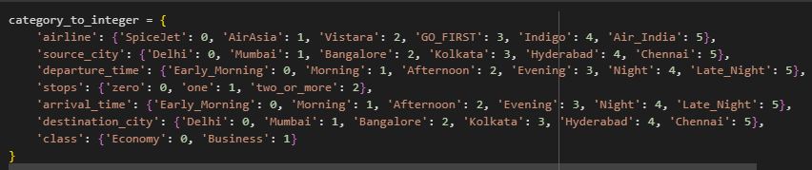
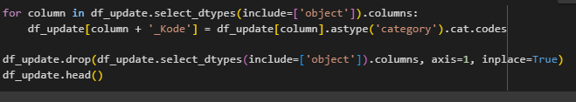
Encoding

Slide 24
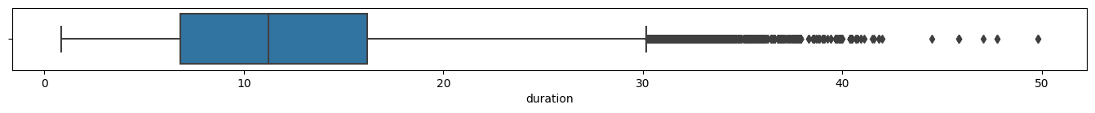
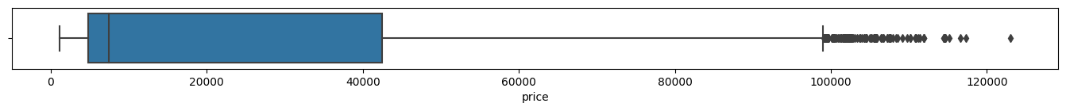
Outlier

Slide 25
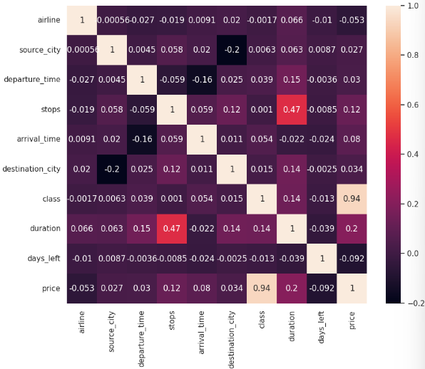
Correlation
Features | VIF
airline | 4.575651
source_city | 2.688538
departure_time | 4.265282
stops | 7.510326
arrival_time | 5.222501
destination_city | 2.897182
class | 1.486338
duration | 5.426501
days_left | 4.035668

Slide 26
Correlation
Features | VIF
airline | 4.575651
source_city | 2.688538
departure_time | 4.265282
stops | 7.510326
arrival_time | 5.222501
destination_city | 2.897182
class | 1.486338
duration | 5.426501
days_left | 4.035668
Features | VIF
airline | 4.542652
source_city | 2.634899
departure_time | 4.262613
arrival_time | 4.849482
destination_city | 2.820938
class | 1.482467
duration | 4.026593
days_left | 3.931267

Slide 27
Modelling

Slide 28
Model Train And Test Without Preprocessing
Model | R2 Score | RMSE | MAPE
LinearRegression | 0.9052034603234 | 6995.0620983632 | 0.4320129203721
Lasso | 0.9052026963204 | 6995.0902862978 | 0.4318007585726
Ridge | 0.9052033692586 | 6995.0654582108 | 0.4320109215858
KNeighborsRegre | 0.7398822505392 | 11587.248630381 | 0.7326375993887
DecisionTreeRegressor | 0.9759399429733 | 3524.0629542049 | 0.0765773517678
RandomForestRegressor | 0.9897537249219 | 2759.2232179662 | 0.0733376172731
XGBRegressor | 0.9765299141909 | 3480.5884173997 | 0.1501334619304

Slide 29
Model Train And Test After Preprocessing
Model | R2 Score | RMSE | MAPE
LinearRegression | 0.8972397679329 | 7282.9590843774 | 0.3791949514061
Lasso | 0.8972395984531 | 7282.9650901721 | 0.3791765398946
Ridge | 0.8972397060080 | 7282.9612787880 | 0.3792056469452
KNeighborsRegre | 0.7411215972939 | 11559.611597927 | 0.7231749204483
DecisionTreeRegressor | 0.9751404622362 | 3582.1342361619 | 0.0785676608484
RandomForestRegressor | 0.9845849844518 | 2817.0362050172 | 0.0759097713299
XGBRegressor | 0.9762581726524 | 3500.6799174478 | 0.1537592994246

Slide 30
Model
No | Feature | Coefficient
1 | class | 0.879856
2 | duration | 0.060545
3 | days_left | 0.018705
4 | airline | 0.010742
5 | destination_city | 0.010336
6 | Source_city | 0.010302
7 | arrival_time | 0.005238
8 | departure_time | 0.004198

Slide 31
Recommendation

Slide 32
Recommendation
It is better to purchase flight tickets more than 20 days before the flight
Choosing late night and early morning flight times is also recommended
Based on modeling results, the determinant of the highest flight price is class and the comparison with other variables is very far. Meanwhile, the time of arrival or departure has an influence on the lowest flight price along with the type of airline.

Slide 33
Thanks
galyrizq@gmail.com
www.linkedin.com/in/galy-rizq-prima/
github.com/galyrizq

